Slide 1

ZAHA HADID
Only rarely does an architect emerge with a philosophy and approach to the art form that influences the direction of the entire field. Such an architect is Zaha Hadid..." -- Bill Lacy, architect

Slide 2
Zaha Hadid was born on 31 October 1950 in Baghdad, Iraq.
She received a degree in mathematics from the American University of Beirut before moving to study at the Architectural Association School of Architecture in London.
She joined OMA (office of metropolitan architecture) and became a partner in (1977).
She started her own practice in1980.
In 2004 Hadid became the first female and first Muslim recipient of the Pritzker Architecture Prize, architecture’s equivalent of the Nobel Prize.

Slide 3

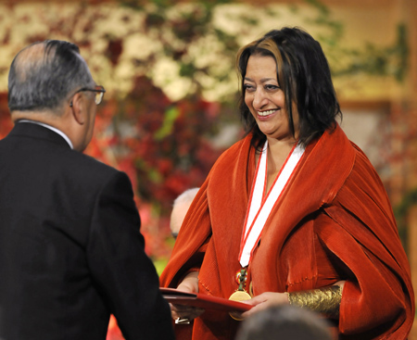

Slide 4
Hadid first became interested in architecture at age eleven, although she pursued other interests before attending architecture school.
A friend of the family was designing a home for Hadid's aunt and would bring the models by and show Zaha. Her mother and father increased her interest by taking her to architectural exhibitions.
Before pursuing higher education in architecture, Hadid studied mathematics at the American University in Beirut in 1968.
The field of modern mathematics and the relationship between philosophy, physics and math interested her briefly before she studied architecture.

Slide 5
SOME LESSER KNOWN FACTS ABOUT ZAHA HADID:
Hadid does not live in a shiny pod but in a “surprisingly conventional” space that is a five-minute walk from her firm’s London offices. She owns the top floor of a non-descript building, where she lives alone (she has never been married). The entirely white space is filled with furniture and paintings, all of which she created. She is not a collector of the works of others!
Her fondness for the off-kilter was seeded by an asymmetric mirror in her childhood home in Baghdad (she hasn’t been back since 1980). “I was thrilled by that mirror,” she once told the London Times. “It started my love of asymmetry.”
Bibliography: https://www.mediabistro.com/unbeige/five-things-you-probably-didnt-know-about-zaha-hadid_b7626

Slide 6
Interior architecture and product design:
She has also undertaken some high-profile interior work, including fluid furniture installations within the Georgian surroundings of Home House private members club in Marylebone, and the Z.CAR hydrogen-powered, three-wheeled automobile.
In 2007 Zaha Hadid designed the Moon System Sofa for leading Italian furniture manufacturer B&B Italia.
In 2009 she worked with the clothing brand Lacoste, to create a new, high fashion, and advanced boot. In the same year, she also collaborated with the brassware manufacturer Triflow Concepts to produce two new designs in her signature parametric architectural style.

Slide 7
PHILOSOPHY
Zaha Hadid is an architect who consistently pushes the boundaries of architecture and urban design. Her work experiments with new spatial concepts intensifying existing urban landscapes in the pursuit of a visionary aesthetic that encompasses all fields of design, ranging from urban scale through to products, interiors and furniture.
Zaha Hadid’s built work has won her much academic and public acclaim.
This dissension between Arab and Western influences reoccurred as she developed her architectural style.
Hadid shatters both the classically formal, rule bound modernism of Mies van der Rohe and Le Corbusier and the old rules of space — walls, ceilings, front and back, right angles. She then reassembles them as what she calls “a new fluid, kind of spatiality of multiple perspective points and fragmented geometry, designed to embody the chaotic fluidity of modern life.

Slide 8
Hadid’s architecture denies its own solidity. Short of creating actual forms that morph and change shape – still the stuff of science fiction – Hadid creates the solid apparatus to make us perceive space as if it morphs and changes as we pass through.
Daniel Libeskind, says , she does not say that a shape symbolises this or that. And she wears her cultural identity lightly. Noticeably, and uncharacteristically diplomatically, she has declined to comment on the situation in Iraq. Instead Hadid lets her spaces speak for themselves. This does not mean that they are merely exercises in architectural form. Her obsession with shadow and ambiguity is deeply rooted in Islamic architectural tradition, while its fluid, open nature is a politically charged riposte to increasingly fortified and undemocratic modern urban landscapes.

Slide 9
CONCEPT
GRAVITY-DEFYING
FRAGMENTARY
REVOLUTIONARY
DECONSTRUCTIVISM
A MAIN THEME OF HADID'S DESIGNS EXHIBITS THAT A BUILDING CAN FLOAT AND DEFY GRAVITY.

Slide 10
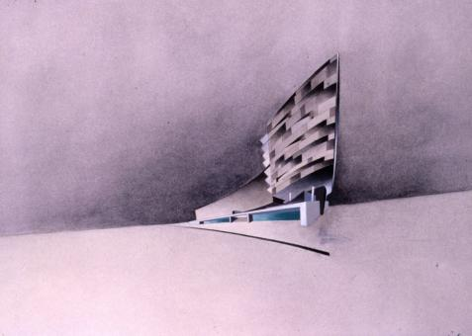
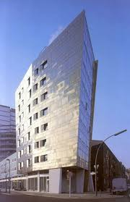
ZAHA WORKS
IBA HOUSING (1986-1993)
3-floor housing development with a wedge-shaped, metal-clad 8-floor tower for the Internationale Bauausstellung.
First realized project along with VITRA FIRE STATION.

Slide 11
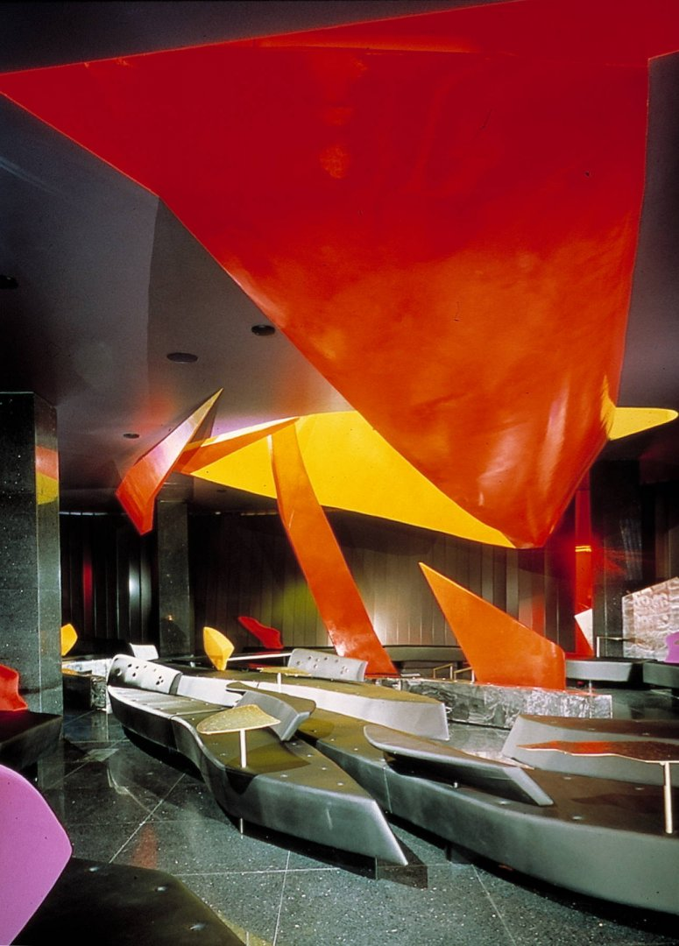

MONSOON RESTAURANT (1989–90)
Two-fold programme of formal eating and relaxed lounging an opposition of moods was created. The result is two synthetic and strange worlds: fire and ice.

Slide 12
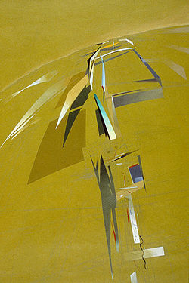
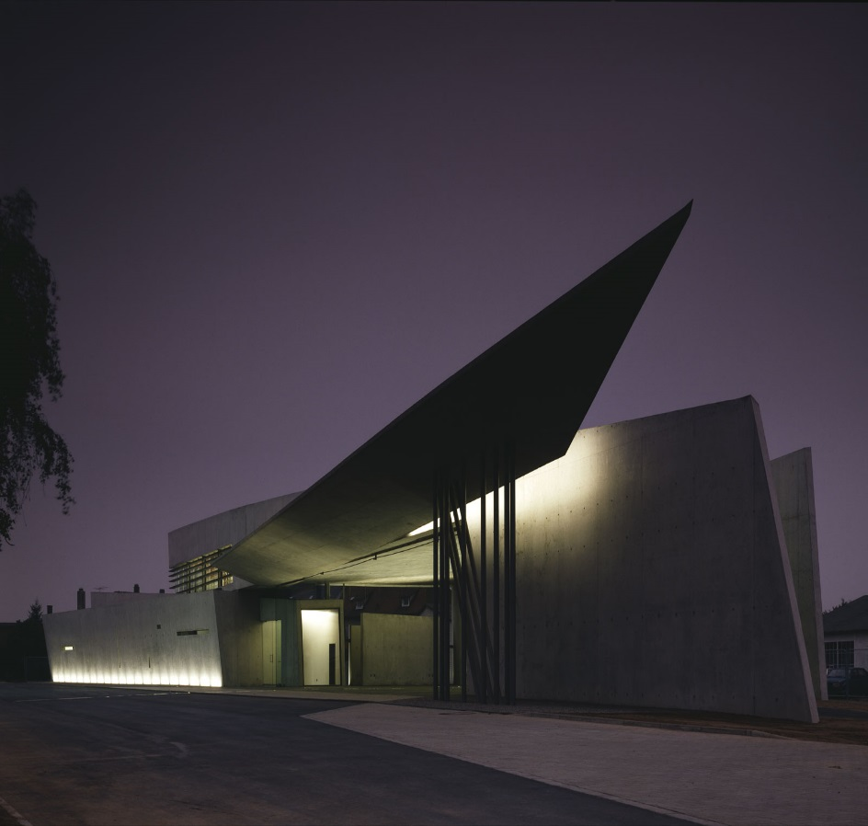
VITRA FIRE STATION (1994)
Conceived as the end note to existing factory buildings, the Vitra Fire Sattion defines rather than occupies space-emerging as a linear, layered series of walls, between which program elements are contained- a representaton of “movement frozen” – an alert structure ready to explode into action any moment.

Slide 13
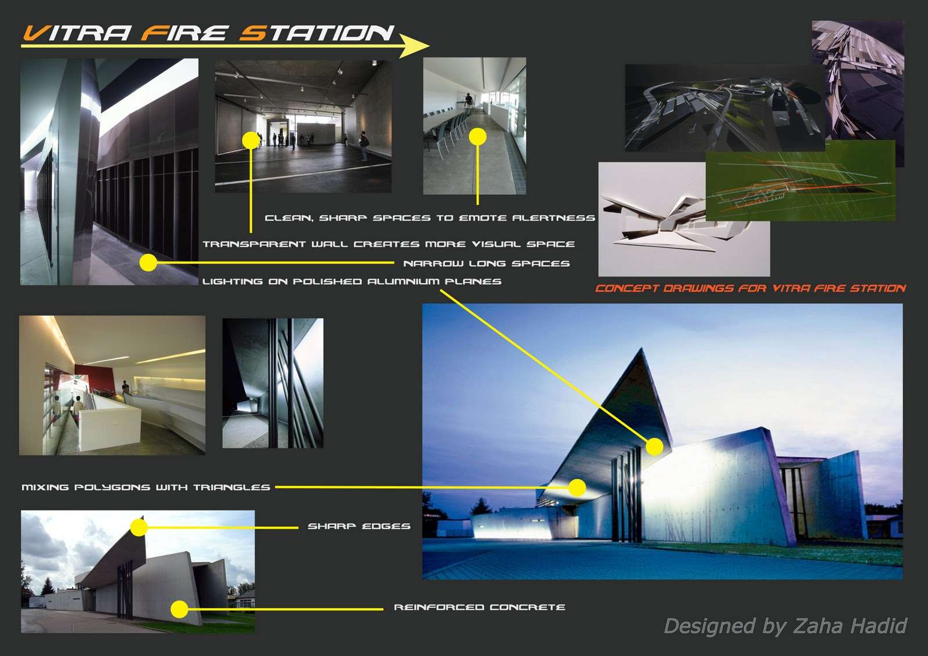

Slide 14
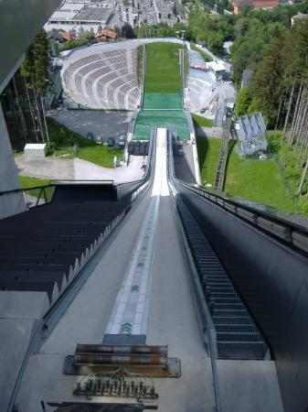
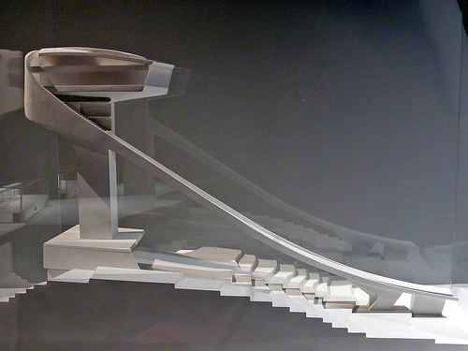
BERGISEL SKI JUMP (2002)
It contains ski ramp and sports facilities, public sapces including a tower top cafeand viewing terrace. Rising to a height of almost 50m the structure’s distinctive form and slhoutte extends the topography of the ski slopes below into the alpine sky above.

Slide 15
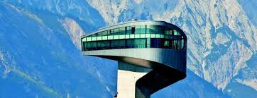
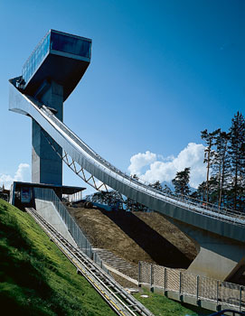
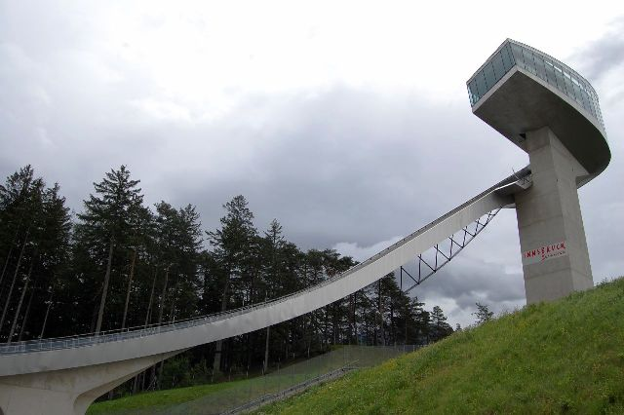
BERGISEL SKI JUMP (2002)

Slide 16
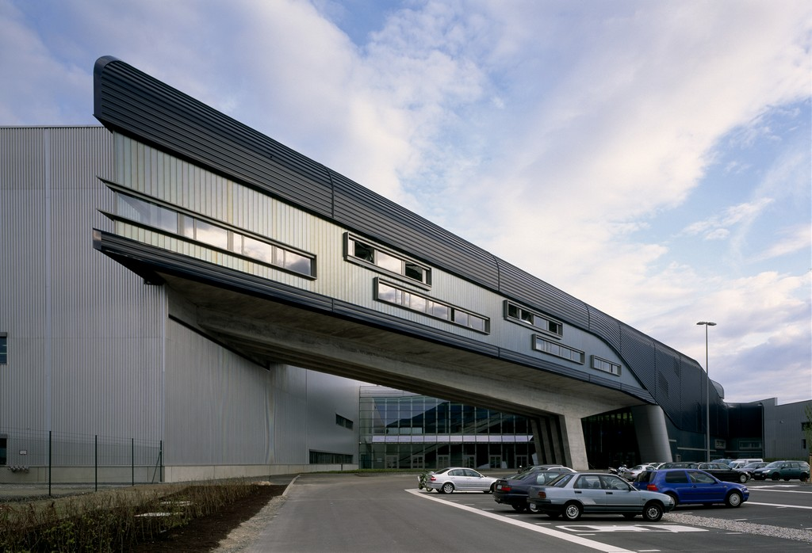
BMW CENTRAL BUILDING
Location: Leipzig, Germany
Client: BMW AG, Munich, Germany
Building Footprint: 250,000 square feet (23,000 m²)
Total Area: 270,000 square feet (25,000 m²)
Building Cost: $60 million
Groundbreaking: March 2003
Completion: May 2005
Employees in Factory: 5,500
Program: Control Functions, Offices/Admin., Meeting rooms, Cafeteria, Public Relations
Parking: 4,100 Spaces
Total Complex Cost: $1.55 Billion

Slide 17
BMW CENTRAL BUILDING
The BMW factory prior to the construction of the central building existed as three disconnected buildings.
There was a need for a central building to function as the physical connection of the three units. It also needed to house the administrative and employee needs spaces.
Hadid's design took this idea of connectivity and used it to inform every aspect of the new building. It serves as a connection for the assembly process steps and the employees.
Designed as a series of overlapping and interconnecting levels and spaces, it blurs the separation between parts of the complex and creates a level ground for both blue and white collar employees, visitors, and the cars.

Slide 18
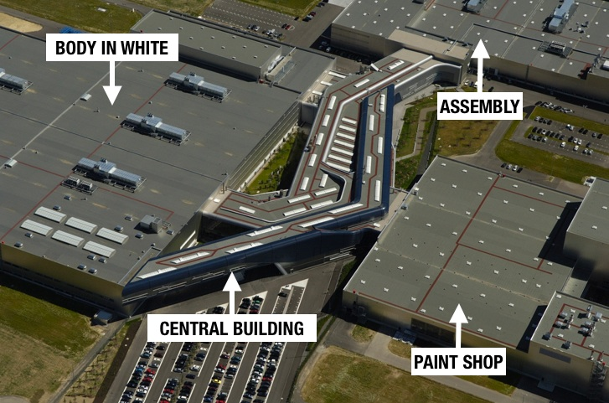
BMW CENTRAL BUILDING

Slide 19
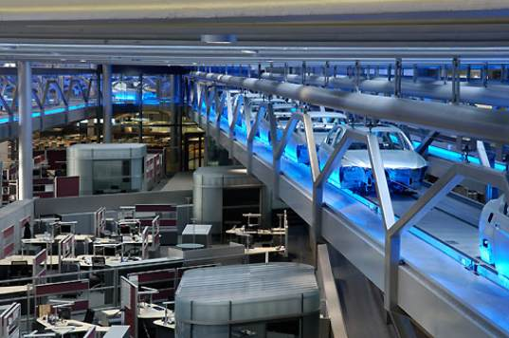
BMW CENTRAL BUILDING
Image : Cars moving on the conveyor belt and administrative office on the side below the conveyor.

Slide 20
AWARDS
•2008 Forbes ranked Hadid the 69th most powerful women in the world.
• 2010 New Statesman ranked her the 42nd most influential figure on the planet.
• 2001 Equerre d'argent Prize, special mention
• 2003 European Union Prize for Contemporary Architecture
• 2004 Pritzker Prize
• 2005 Designer of the Year Award for Design Miami
• 2005 RIBA European Award for BMW Central Building
• 2006 RIBA European Award for Phaeno Science Center
• 2007 Thomas Jefferson Medal in Architecture
• 2008 RIBA European Award for Nordpark Cable Railway
• 2009 Praemium Imperiale
• 2010 RIBA European Award for MAXXI
• 2010 Stirling Prize for MAXXI – National Museum of the 21st Century Arts
• 2011 Stirling Prize for Evelyn Grace Academy, London

